Slide 2
Eligible Costs & Funding Rates
Budget preparation

Slide 3


Eligibility for Funding – General Rules
Eligible for funding are legal entities established in:
  Member States
  Associated Countries
  Countries listed in Annex 1 of the Work Programme (https://ec.europa.eu/info/funding-tenders/opportunities/docs/2021-2027/common/guidance/list-3rd-country-participation_horizon-euratom_en.pdf)
Legal entities established in other Countries may be funded when:
  Agreement exists between 2 funding bodies
  Provision made in the call text
  Commission deems participation essential for carrying out the action

Slide 4

What funding rate applies?
  100% (RIA, CSA, ERC) or 70 % (IA) funding rate for
  Actual costs, directly linked to the implementation of the action
  Flat-rate for indirect costs/overhead costs
  Marie Skłodowska Curie Actions
  Fixed Unit cost rates cover researcher costs and institutional costs

Slide 5





Horizon Europe – Model Grant Agreement (Annex 2): cost categories
  A. Personnel costs
    A.1 Employees
    A.2 Natural persons under direct contract
    A.3 Seconded persons
    A.4 SME owners and natural person beneficiaries
  B. Subcontracting costs
  C. PURCHASE COSTS
    C.1 Travel and subsistence
    C.2 Equipment
    C.3 Other goods, works and services
  d. OTHER COST CATEGORIES
  (If allowed by the call)
    D.1 Financial support to third parties
    D.2 Internally invoiced goods and services
    [D.3 Transnational access to research infrastructure unit costs]
    [D.4 Virtual access to research infrastructure unit costs]
    [D.5 PCP/PPI procurement cost]
    [D.6 Euratom Cofund staff mobility costs]
    [D.7 ERC additional funding]
    [D.8 ERC additional funding (subcontracting, FSTP and internally invoiced goods and services)]
  E. INDIRECT costs

Slide 6
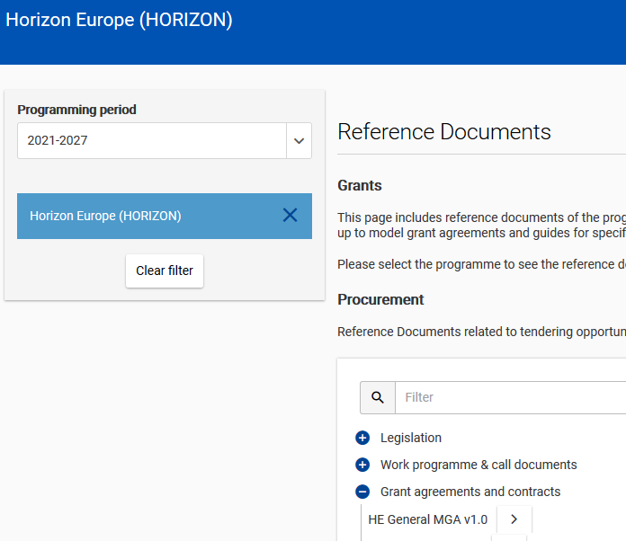
https://ec.europa.eu/info/funding-tenders/opportunities/portal/screen/how-to-participate/reference-documents;programCode=HORIZON

Slide 7

Direct costs
  = directly linked to the implementation of the action
  Examples:
      Personnel costs
      Subcontracting
      Purchase costs (Travel, equipment,
      other goods, works and services)
      Other cost categories
  Actual costs chargeable to the project, no estimated costs

Slide 8

Indirect costs
= not directly linked to the action
Examples:
    Rents, electricity, heating, office equipment, furniture, phone costs, postage, printing and copy costs, administrative costs
    Paid as a 25% as flat rate of the direct eligible costs (except e.g. subcontracts!)

Slide 9
Lump sum funding
  Lump sum funding is getting more common in Horizon Europe!
  Simplification: costs to be calculated at proposal stage, but no reporting of actual costs and resources during project implementation.
  Reporting focuses on implementation of the action, of Work-Packages, etc.
  How to know if a Horizon Europe topic is using lump sum funding?
  When a topic under Horizon Europe makes use of lump sum funding, this is specified in the "specific conditions" of the topic in the work programme, under "Legal and financial set-up of the Grant".
  Lump sum funding web-page:
  https://ec.europa.eu/info/funding-tenders/opportunities/portal/screen/programmes/horizon/lump-sum/guidance

Slide 10

Marie Skłodowska Curie Actions
Unit costs organised in several cost categories are used instead of the general cost forms
These are fixed amounts that must be multiplied by the number of months the recruited researchers spent on research training activities (person-months)
Different unit cost categories cover
    Salary of the fellows
    research and training costs of the fellows
    Costs related to project implementation

Slide 11
Budgeting a proposal

Slide 12
How to budget a proposal?
    Calculate your costs on a realistic and reasonable basis, as you expect it to appear and to be eligible in the action.
    Budget should be calculated according to the action needs
    Demonstrates a clear vision of objectives and tasks in an action
    Minimises potential changes during the runtime of an action
    Appropriate budget estimation and distribution is part of the evaluation!

Slide 13


Don‘t forget financial buffers
Plan
Reality

Slide 14
Direct costs are eligible if…
Actually incurred by the beneficiary during the life of the action (with a few exceptions)
Indicated in the estimated budget
In connection with the action as described in the action description and necessary for its implementation
Identifiable and verifiable, in particular recorded in the beneficiary´s accounts
In compliance with applicable national law on taxes, labour and social security
Reasonable, justified and must comply with the principle of sound financial management
Evaluators will approve the necessity for the activity and the related costs

Slide 15
Daily rate provisions
Direct COST - PERSONNEL COSTS

Slide 16

Personnel costs in HE
Use of a single corporate daily rate and calendar year approach
Days worked
in the project
Personnel costs
Daily rate

Slide 17
Daily rate calculation
        actual annual personnel costs for the person
        215*
Daily rate
*For Horizon Europe: Still possible to deduct actual working days spent on parental leave from the fixed number of 215 days
Disclaimer: Information not legally binding

Slide 18
Daily rate calculation
When?
per calendar year (from January to December)
except for the months running from the end of the last calendar year until the end of the reporting period. For those months, you must calculate a separate partial daily rate as follows:
  {actual personnel costs of the person incurred over those months
  divided by
  {215 / 12 (months) x number of months from the January until the end of the reporting period}}

Slide 19
Example
2021
actual personnel costs incurred for that person in 2021
215
X
days worked by that person on the action from 1/09/2021
2022
actual personnel costs incurred for that person in 2022
215
X
days worked by that person on the action in 2022
2023
actual personnel costs incurred for that person until 31/03/2023
(215 / 12 x 3)
X
days worked by that person on the action until 31/03/2023
Costs for Researcher Y in reporting period 1. Reporting period 1 runs from 1/09/2021 until 31/03/2023:
Personnel Costs RP1

Slide 20
Days worked – record keeping
use reliable time records (i.e. time-sheets) either on paper or in a computer-based time recording system.
Or
sign a monthly declaration on days spent for the action (template under development).
Days worked
Disclaimer: Information not legally binding

Slide 21
Purchase Costs and Subcontracting
Direct costs

Slide 22
When are travel costs eligible?
Travel and subsistence costs for personnel and external experts are eligible if they fulfil the general conditions to be eligible (i.e. incurred during the action duration, necessary, linked to the action, etc.)
According to the usual practices on travel of the beneficiary
No distinction between travelling in or outside of Europe
Particularly expensive travels: With approval of the Project Officer

Slide 23

Equipment costs
Depreciation costs are by default eligible.
By exception, full costs may be eligible.
Optional provisions addressing the specific case of assets under construction (e.g. prototype) and their related capitalised costs:
The full construction costs (typically the costs of the personnel involved in the construction of the prototype)
The full purchase costs (typically any component, pieces of equipment bought for the prototype)
Continuity
Further clarity

Slide 24
When are contracts for services, works or goods eligible?
These are ordinary contracts for services, works (i.e. buildings) or goods (e.g. equipment), needed to carry out the action, including the purchase of consumables and supplies.
These contracts do not have to be indicated in the description of the action
The beneficiary must award the contracts on the basis of best value for money (or lowest price) and absence of conflict of interests
The eligible costs are the prices charged to the beneficiary by the contractors

Slide 25
When are subcontracting costs eligible?
          Subcontractors
            If necessary for the implementation of the action
            They carry out action tasks for the beneficiary
            Selected based either on best value for money or on the lowest price
            Issue invoices including profit, charge market prices
            The tasks to be implemented and the estimated cost for each subcontract must be indicated in the proposal

Slide 26
Horizon Europe specific provisions
indirect costs

Slide 27
Indirect costs
What?
Costs that are only indirectly linked to the action implementation
(Art. 6(1) General eligibility conditions of the Horizon Europe MGA)
continuity
Flat-rate of 25% of the eligible direct costs, except subcontracting costs, financial support to third parties and exempted specific cost categories, if any.
(Art. 6(2)(E) Indirect costs of the Horizon Europe MGA)
NEW
  Possibility to accept actual indirect costs allocated via beneficiary’s usual key drivers in the unit cost calculation for internally invoiced goods and services

Slide 28
in Horizon Europe
Lump sum Funding /grants

Slide 29
Why does the EC use lump sum funding?
  Reducing the financial error rate
  Following the ECA annual reports 2019 and 2020, there is wide agreement that the error rate in the R&I Framework Programmes must be reduced
  Lump sums are a key measure to achieve this in Horizon Europe
  Significant simplification potential
  Funding based on reimbursement of real costs remains complex and error-prone. Little scope for further simplification
  Lump sums remove the obligation to report actual costs and resources
  Easier to use for beneficiaries with limited experience
  Focus on content
  Focus less on financial management and more on content

Slide 30
Writing a lump sum proposal
  To write a lump sum proposal, you:
    Use the standard Horizon Europe application form
    Present the objectives and methodology of your project and address the expected outcomes and impacts as in any Horizon Europe proposal
    Describe in detail the activities covered by each work package.
  To define and justify the lump sum, you need to provide a detailed budget table with cost estimations.
  The detailed budget table is an Excel file. You must download it from the online submission system, fill it and submit it as an annex to the Part B of your application form.

Slide 31
Writing a lump sum proposal
  In this detailed budget table, you provide cost estimations for each cost category per beneficiary (and affiliated entity if any) and per work package.
  The cost estimations must be an approximation of your actual costs. They:
    are subject to the same eligibility rules as in actual costs grants
    must be in line with your normal practices
    must be reasonable / non-excessive
    must be in line with and necessary for your proposed activities.
  The cost estimations are used to generate in the detailed budget table a breakdown of lump sum shares per work package and per participant.
  Details and instructions on how to fill in the lump sum detailed budget table are provided in the Funding & Tenders portal.

Slide 32
Budget allocation
  Budget allocation (annex 2 to the grant agreement)
 | WP1 | WP2 | WP3 | WP4 | WP5 | WP6 | WP7 | WP8 | Total
Beneficiary A | 250.000 |  |  | 50.000 | 300.000 | 250.000 |  | 300.000 | 1.150.000
Beneficiary B |  | 250.000 | 350.000 | 50.000 |  |  | 100.000 | 150.000 | 900.000
Beneficiary C | 100.000 | 100.000 |  | 50.000 |  | 280.000 |  |  | 530.000
Beneficiary D |  | 120.000 |  | 50.000 |  |  | 100.000 | 150.000 | 420.000
Total | 350.000 | 470.000 | 350.000 | 200.000 | 300.000 | 530.000 | 200.000 | 600.000 | 3.000.000
Shares of the lump sum per beneficiary
Lump sum
=
Maximum grant amount
Shares of the lump sum per WP
  You can use the budget as you see fit as long as the project is implemented as agreed. The actual distribution of the lump sum is invisible to us.
  Budget transfers between work packages and/or partners require an amendment if the consortium wants to reflect them in the grant agreement.

Slide 33

Ex-post controls
Checks, reviews and audits for:
Proper implementation of the action (e.g. technical review)
Compliance with the other non-financial obligations of the grant, e.g.
  IPR obligations
  Ethics and integrity
  Open science
  Dissemination
  Etc.
No financial checks, reviews and audits by EU services

Slide 34
Keeping records
You need (e.g.)
Technical documents
Publications, prototypes, deliverables
…any document proving that the work was done as detailed in Annex 1
You don't need
Time-sheets
Pay-slips or contracts
Depreciation policy
Invoices
…any documents proving the actual costs incurred
Documentation required by good research practices such as lab books
Same as for all Horizon Europe grants

Slide 35

Resources available
One dedicated lump sum page on the Funding &Tenders Portal with:
Guidance documents
What do I need to know? & Quick guide
Reference documents
Model Grant Agreement Lump Sum
Decision authorising the use of lump sum contributions under the Horizon Europe Programme
Studies
European Commission assessment (October 2021)
European Parliament (STOA) study on lump sums in Horizon 2020 (May 2022)
Events
Future events
Past events and recordings
Funding opportunities
List of Horizon Europe topics using lump sum funding
Frequently asked questions
Detailed guidance for participants
Lump sum briefing slides for experts

Slide 36
Horizon Europe specific provisions
PROJECT-BASED REMUNERATION

Slide 37





Project-based remuneration at a glance
  What is it?
  Usual remuneration practices of a legal entity under which a personnel receives supplementary payments for work in projects
  How MUCH CAN BE DECLARED?
  Actual remuneration costs paid by the legal entity for the time worked by the personnel in the action (‘action daily rate’) up to the remuneration that the person would be paid for work in R&I projects funded by national schemes (‘national projects daily rate’)
  METHODOLOGY?
  Compare
  Take the lower of the two.
*
Example:
an employee who gets a bonus or a new contract with a higher salary level for working in a project.
*
Usually based on:
either regulatory requirements (such as national law or collective labour agreements)
or your written internal remuneration rules

Slide 38
Horizon Europe Model Grant Agreement
THIRD PARTIES

Slide 39


Affiliated entities
Article 187 (1)(b) of the EU Financial Regulation:
Entities ‘that have a link with the beneficiary, in particular a legal or capital link, which is neither limited to the action nor established for the sole purpose of its implementation’.
Affiliated entities in Horizon Europe = Linked third parties in Horizon 2020
(alignement of labelling/definition in the corporate context)
Disclaimer: Information not legally binding

Slide 40
Associated Partner (AP)
Inherited and derived from the ‘International partner’ status in H2020 MGA
Corporate terminology and status with the following features:
AP does work but cannot declare costs
AP can be linked:
  either to one or more beneficiaries
  or with the whole consortium
The beneficiaries must ensure that some of MGA obligations also applied to AP (i.e. Articles 11 (proper implementation), 12 (conflict of interests), 13 (confidentiality and security), 14 (ethics), 17.2 (visibility), 18 (specific rules for carrying out action), 19 (information) and 20 (record-keeping)

Slide 41
Proposal: Buget Plan

Slide 42
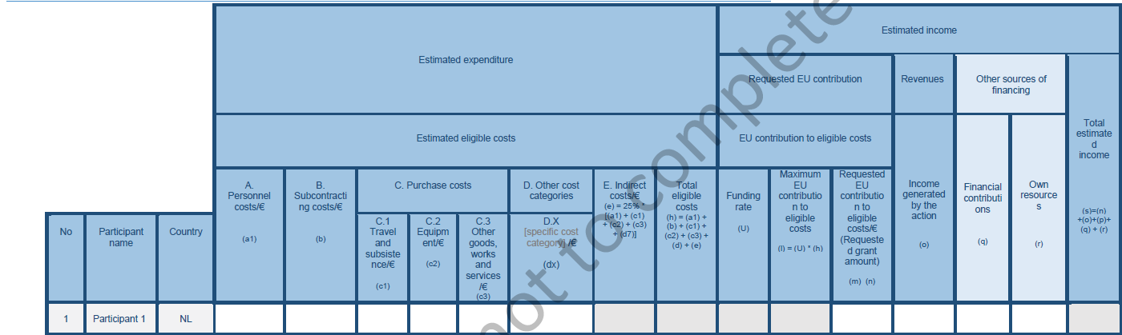
Cost categories have separate columns

Slide 43
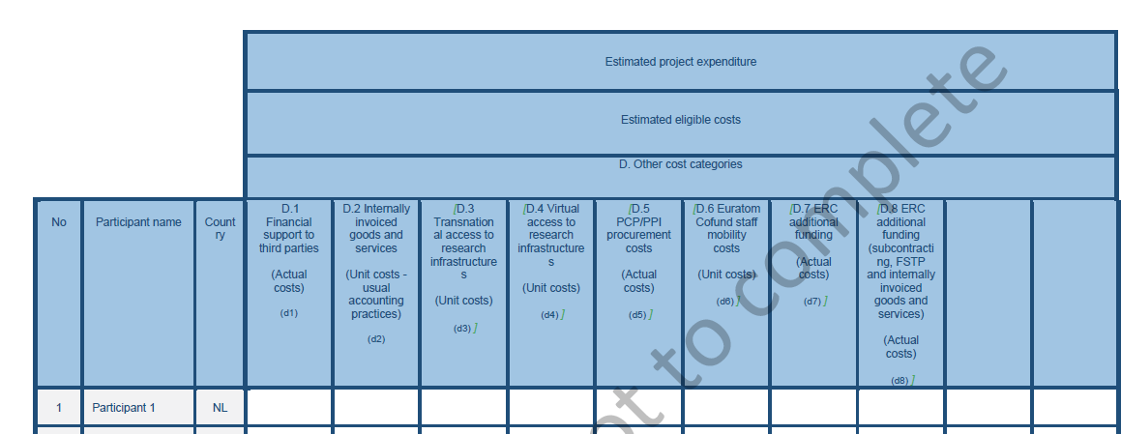
Cost categories – Application form

Slide 44
Key messages
Information source: NCP, Annotated Grant agreement (online…)
Costs must be incurred during the project by the beneficiary and be identifiable and verifiable in the accounts to be eligible
The work that you performed should be described in the work packages of the proposal
Indirect costs – a 25% fixed flat-rate of the eligible direct costs (minus certain direct eligible costs)
Income of projects should be considered at the proposal stage

Slide 45
GROUP WORK

Slide 46
Budgeting a Workpackage
Use your WP descriptions from previous sessions.
What costs have to be covered?
Who has to commit staff time and how much time will be needed?
Who has to travel?
Service needed from companies?
Is there any income/are revenues generated?
Do you know the rules in your organisation?
Additional question: Are there internal issues to be clarified in advance?

Slide 47
Thank you!
# HorizonEU
http://ec.europa.eu/horizon-europe

Slide 48

Time recording system in hours
‘Day-equivalent’: When to do the conversion?
Each time that you have to calculate a daily rate → per calendar year
  For example at the time of a reporting period:
  If a daily rate is calculated for year 2021, the beneficiary must convert into day-equivalents the total number of hours worked by the person on the action during 2021 altogether.
Disclaimer: Information not legally binding

Slide 49
Horizon Europe specific provisions
Certificate on financial statements (CFS)

Slide 50
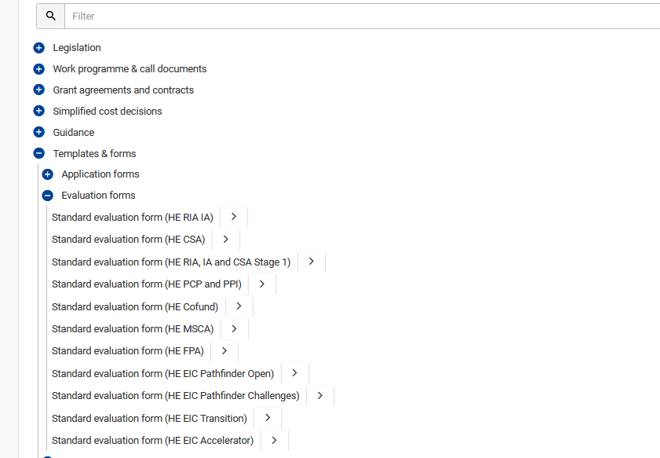
Standard Evaluation forms/Additional information
LINK: https://ec.europa.eu/info/funding-tenders/opportunities/portal/screen/how-to-participate/reference-documents;programCode=HORIZON

Slide 51
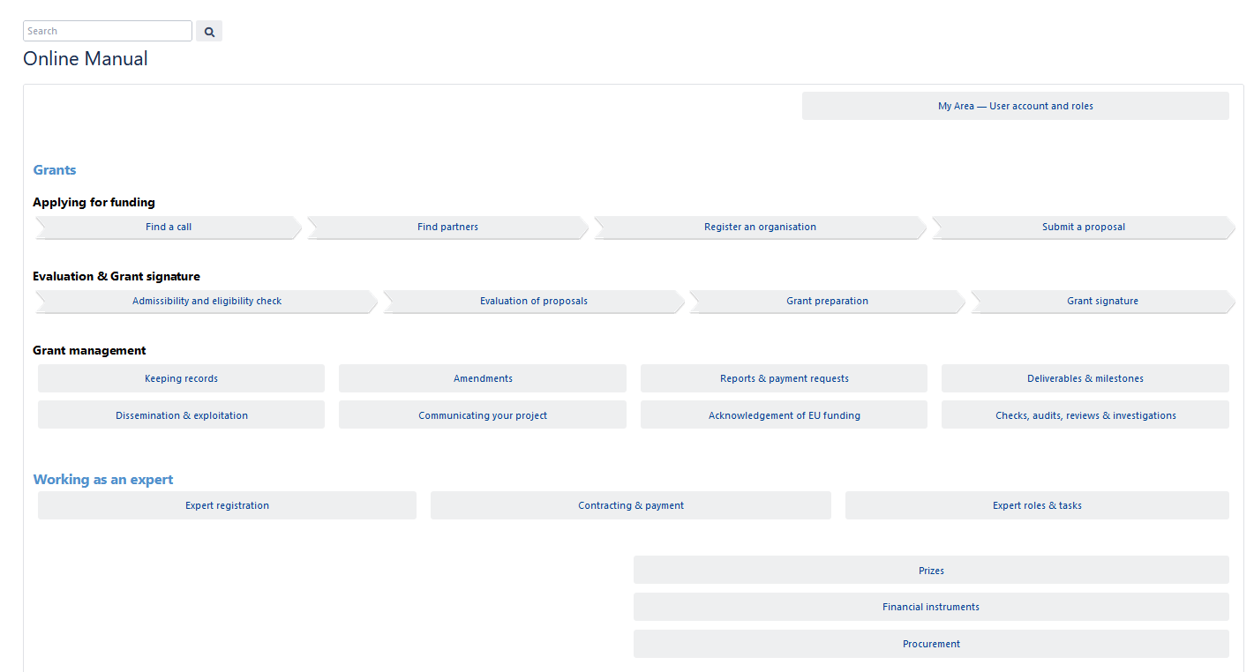
FURTHER OFFICAL INFORMATION AND RESOURCES!
LINK: https://webgate.ec.europa.eu/funding-tenders-opportunities/display/OM/Online+Manual

Slide 52
FURTHER INFORMATION
Funding and Tenders Portal: https://ec.europa.eu/info/funding-tenders/opportunities/portal/screen/home
Reference Documents: https://ec.europa.eu/info/funding-tenders/opportunities/portal/screen/how-to-participate/reference-documents;programCode=HORIZON
Online Manual: https://webgate.ec.europa.eu/funding-tenders-opportunities/display/OM/Online+Manual
How to register you organization (PIC NUMBER): https://ec.europa.eu/info/funding-tenders/opportunities/portal/screen/how-to-participate/participant-register

Slide 53


Certificate on financial statements (CFS)
ALIGNMENT WITH CORPORATE APPROACH
  higher threshold
  EUR 430 000 (increased from EUR 325 000 in H2020)
  CFS to be submitted at payment of the balance
  Simpler calculation base
  Requested EU contribution calculated on all costs (not only actual costs and unit costs calculated in accordance with usual costs accounting practices as in H2020)
  Less cfs for LOW-RISK BENEFICIARIES WITH SPA
  For beneficiaries with a low-risk classification after a SPA the threshold will increase to EUR 725 000 (from EUR 430 000)

Slide 54

In-kind contributions – eligible under HE
  in-kind contributions against payment
  No more special Article (corporate approach):
  But they can still be declared as:
  Seconded persons under Personnel costs provisions
  Other types as purchase of goods, works or services
  Indirect costs calculated on top via the 25% flat-rate
  in-kind contributions free of charge
  Specific provisions (Art 6(1) & Art 9(2)) HE MGA (stemming from Horizon Europe specific legal base)
  They must be declared under the relevant cost category (i.e. as if they were costs incurred by the beneficiary).
  Only direct costs must be reported
  Indirect costs calculated on top via the 25% flat-rate (with exceptions, like for internal invoicing)

Slide 55
Horizon Europe specific provisions
Internally invoiced goods & services

Slide 56
Internal invoicing
What?
Costs for goods and services which are produced or provided within the beneficiary’s organisation directly for the action and the beneficiary values on the basis of its usual cost accounting practices.
Examples:
  self-produced consumables (e.g. electronic wafers, chemicals)
  specialised premises for hosting the research specimens used for the action (e.g. animal house, greenhouse, aquarium)
  standardised testing or research processes (e.g. genomic test, mass spectrometry analysis)
  use of specific research devices or research facilities (e.g. clean room, wind tunnel, supercomputer facilities, electronic microscope)
Wider reliance on beneficiary’s usual cost accounting practices for the unit cost calculation with:
  No application of the 25% flat-rate on top of the unit cost (H2020 rules)
  instead, possibility to accept actual indirect costs allocated via beneficiary’s usual key drivers in the unit cost calculation
NEW

